Slide 1
Facial Recognition with OpenCV
By: Alexander Anderson, Dan Rowe, Liam Sargent, Rob Sullivan

Slide 2

OpenCV -- What We Used

Slide 3
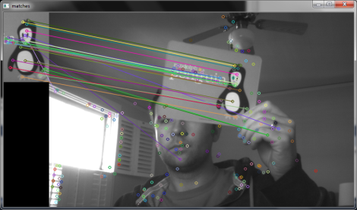
Keypoints with SIFT
sift = cv2.SIFT() kp = sift.detect(gray,None) img=cv2.drawKeypoints(gray,kp)
Scale-invariant feature transform

Slide 4
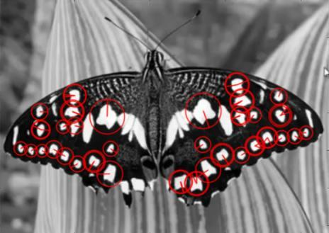
Keypoints with SURF
Speeded-Up Robust Features
surf.detectAndCompute(img,None)

Slide 5

Intelligent Agent?

Slide 6
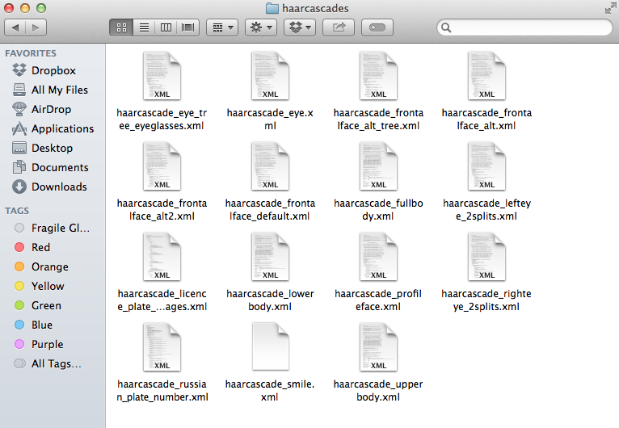
Training Classifiers

Slide 7
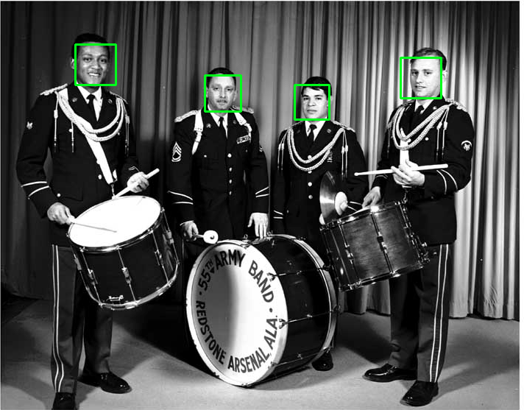
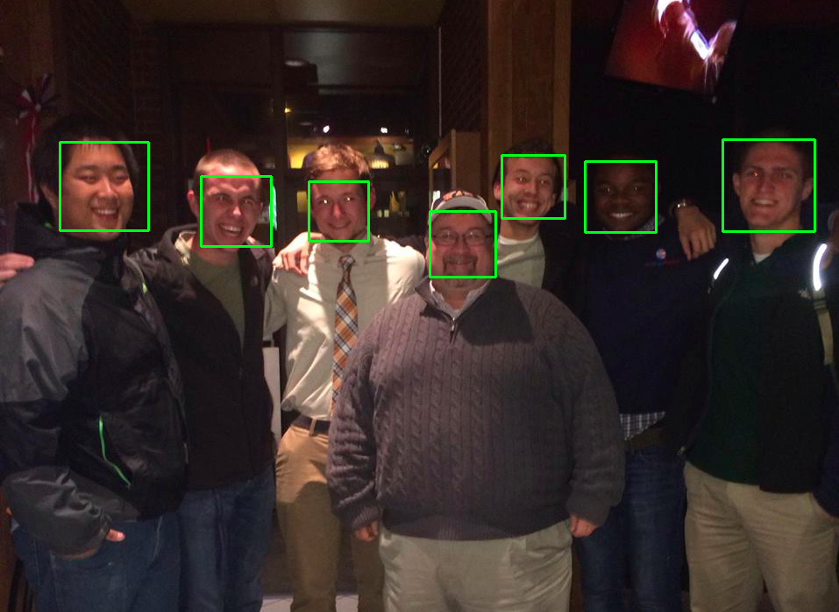
Facial Recognition in Pictures

Slide 8
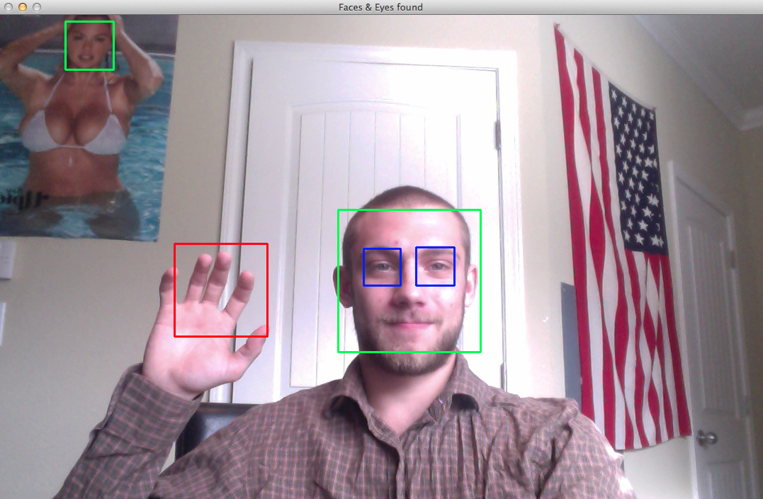
Hand and Eye Recognition in Photos

Slide 9
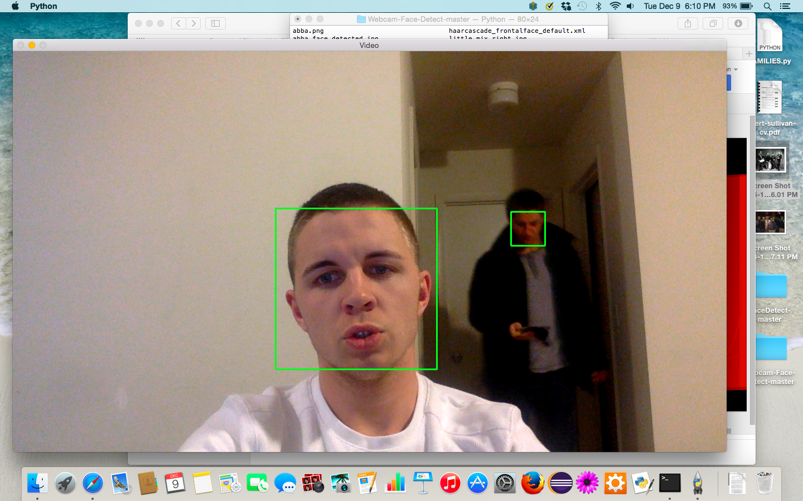
Examples with webcam

Slide 10
Applications

Slide 11
Additional Information

Slide 12
Questions…?

